Slide 1
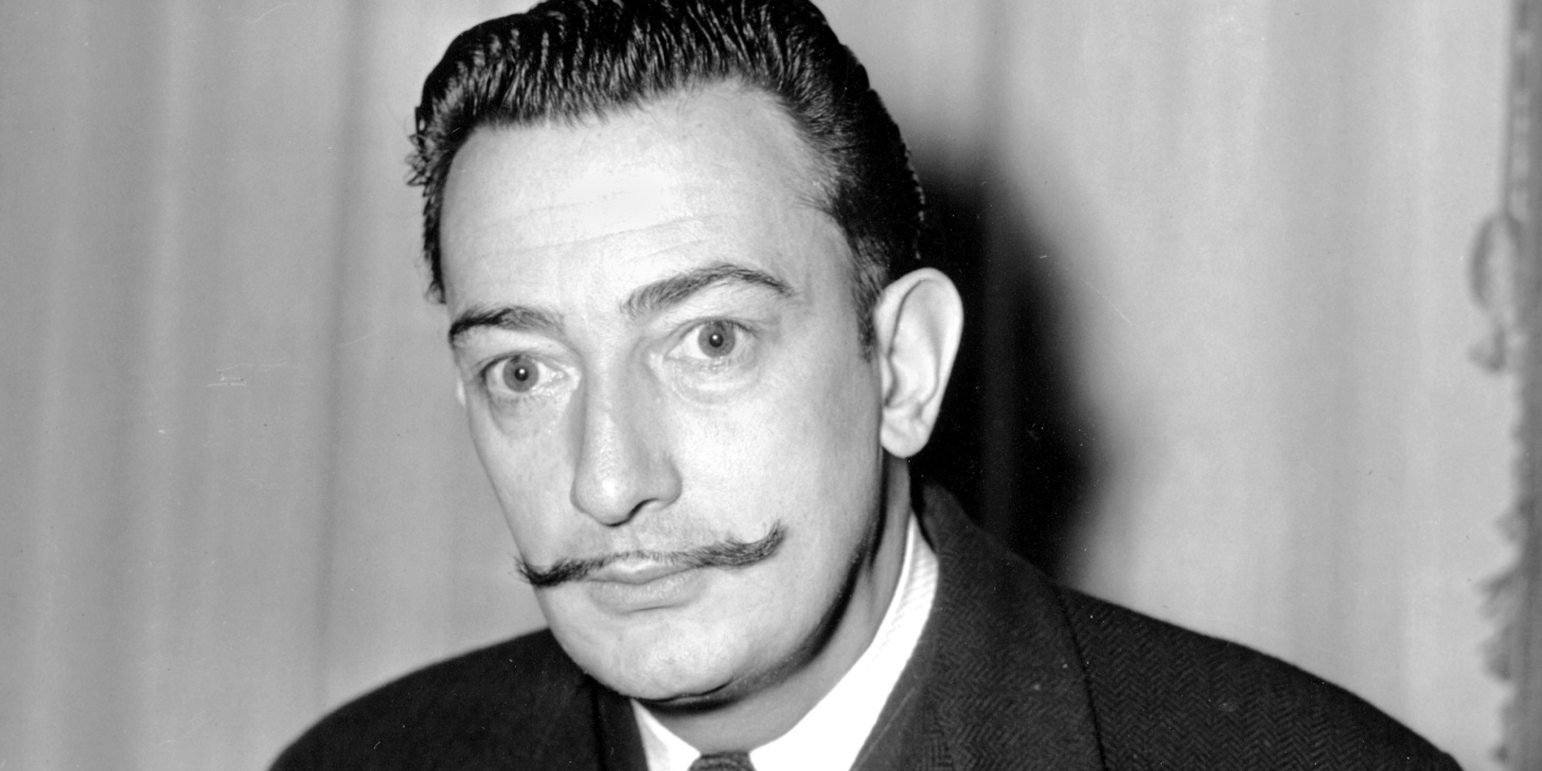
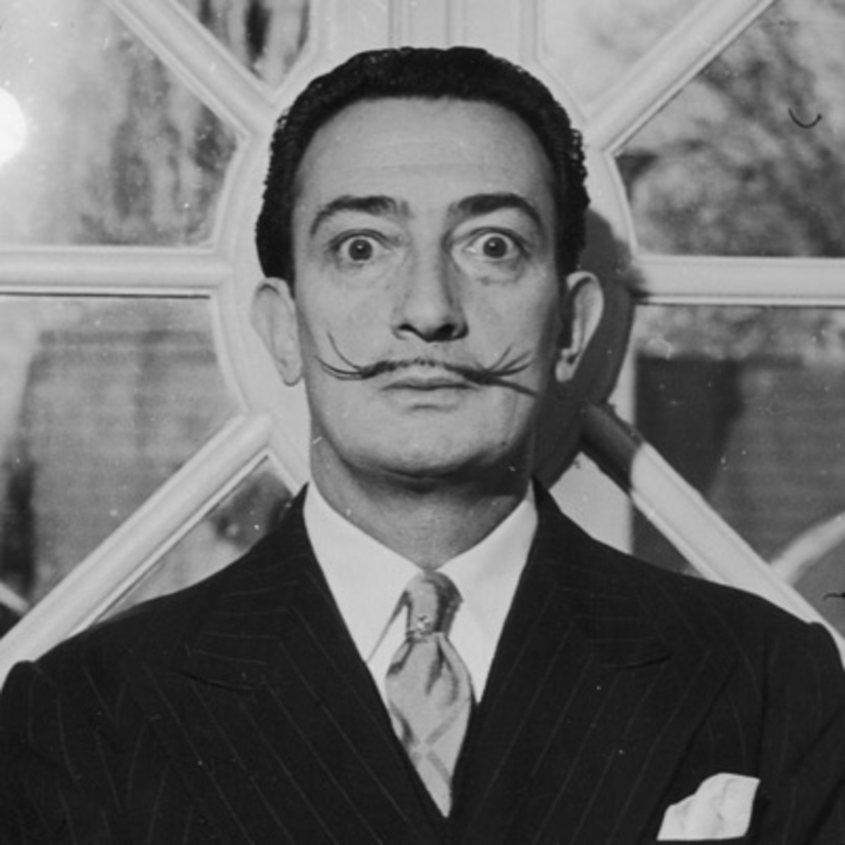
Salvador Dali
Remy Guyett
1904-1989

Slide 2
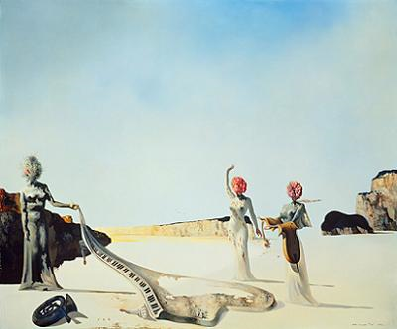
About him
Hes a modern artist, portrayed beautiful and creative paintings using many color schemes
Attended drawing school growing up
Had a big family, unfortunately his brother died when he was young.
Painted with a more curved look, very soft touch
Created a Dali-foundation to protect inside and outside Spanish territory and continues to this day
He has museums in his name

Slide 3
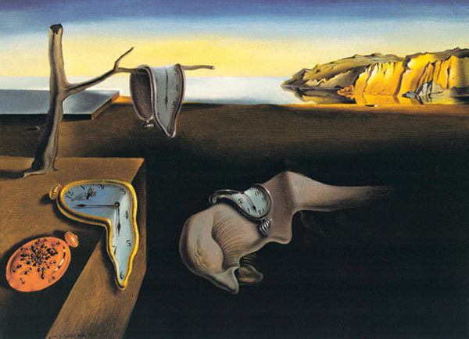
Major characteristics
His work was dream-like and surreal
Worked with curves and space
Colorful color pallet
Some photographs are labeled edgy
Not usual

Slide 4
Elephants this is Salvador Dali’s piece made by oil paint. He used greys and blacks to paint the elephants and used a red ombre to yellow back round

Slide 5
Butterfly this is a very dream like painting. The louds texture is impressive and the color pallet is bright and colorful. It’s a beautiful painting and probably my favorite

